Slide 1

Lecture 10: Main Developments of Cloud Computing Case Study 2: AWS

Slide 2
Activity #1:
Answer the following questions:
What year Amazon started?
What is the complete name of the company?
Who is the founder?
What was the primary business at the time when it was founded?

Slide 3
Amazon Web Services (AWS)
A collection of remote computing services (also called web services) that together make up a cloud computing platform, offered over the Internet by Amazon.com.
Launched in 2006, now businesses in 200+ countries.
The infrastructure consists of compute and storage servers interconnected by high-speed networks and supports a set of services.
The most central and well-known of these services are Amazon EC2 and Amazon S3.
The service is advertised as providing a large computing capacity (potentially many servers) much faster and cheaper than building a physical server farm.
An application developer:
Installs applications on a platform of his/her choice.
Manages resources allocated by Amazon.

Slide 4
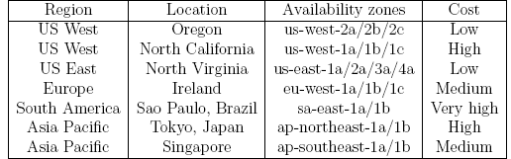
AWS regions and availability zones
Amazon offers cloud services through a network of data centers on several continents.
In each region there are several availability zones interconnected by high-speed networks.
An availability zone is a data center consisting of a large number of servers.
Regions do not share resources and communicate through the Internet.
aws.amazon.com

Slide 5
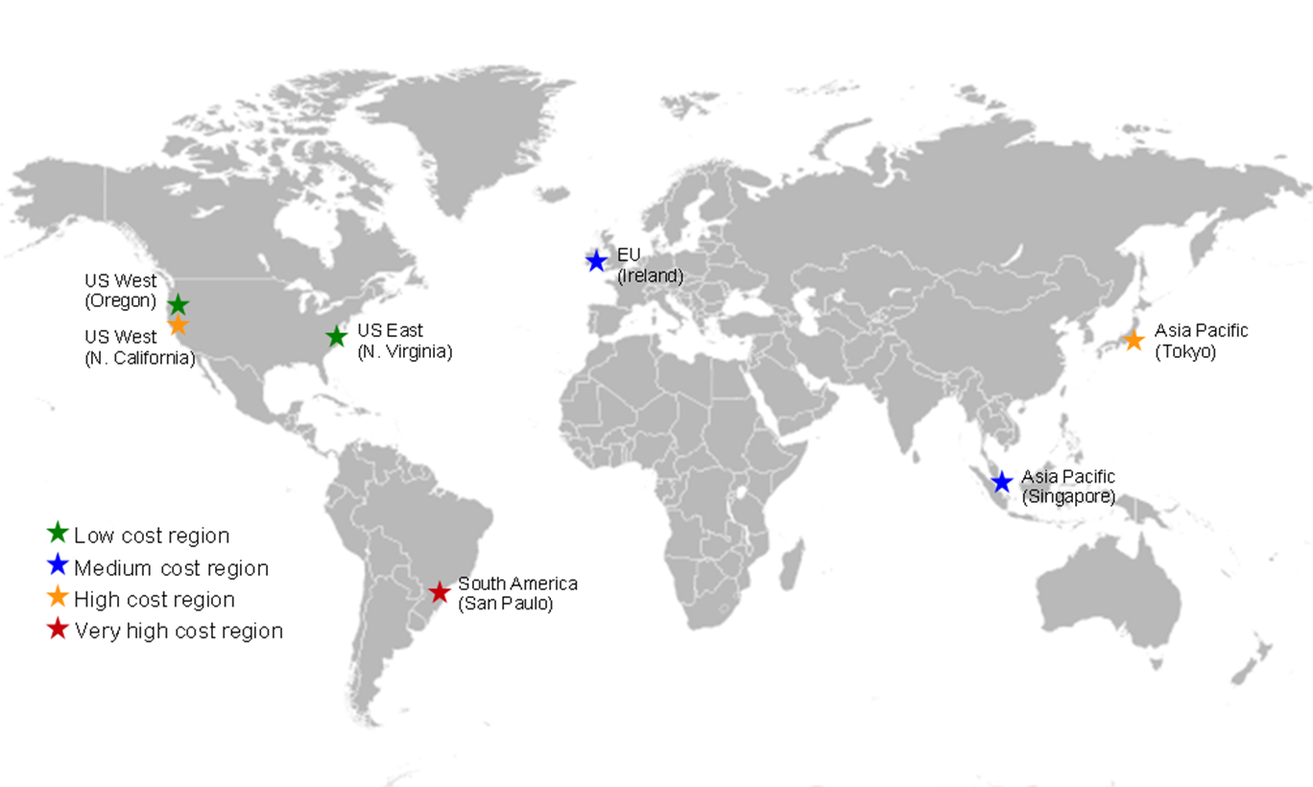
aws.amazon.com

Slide 6
Examples of Amazon Web Services
AWS Management Console - allows users to access the services offered by AWS .
Elastic Cloud Computing (EC2) - allows a user to launch a variety of operating systems.
Simple Queuing Service (SQS) - allows multiple EC2 instances to communicate with one another.
Simple Storage Service (S3), Simple DB, and Elastic Bloc Storage (EBS) - storage services.
Cloud Watch - supports performance monitoring.
Auto Scaling - supports elastic resource management.
Virtual Private Cloud - allows direct migration of parallel applications.

Slide 7
AWS service configuration: a cloud interconnect supports high speed communication among compute and storage servers within a zone; it also supports communication with servers in other available zones and with cloud users via a Network Address Translation (NAT).

Slide 8
AWS Management Console: services offered by AWS are accessible from the console.
aws.amazon.com

Slide 9


Amazon Simple Storage Service (Amazon S3)
Launched in 2006, Amazon S3
Simple storage service offered by AWS
It is storage for the Internet.
Provides object storage through a web service interface.
It is designed to make web-scale computing easier for developers.

Slide 10
S3 – Simple Storage Service
Service designed to store large objects; an application can handle an unlimited number of objects ranging in size from 1 byte to 5 TB.
An object is stored in a bucket and retrieved via a unique, developer-assigned key; a bucket can be stored in a Region selected by the user.
Supports a minimal set of functions: write, read, and delete; it does not support primitives to copy, to rename, or to move an object from one bucket to another.
The object names are global.
S3 maintains for each object: the name, modification time, an access control list, and up to 4 KB of user-defined metadata.
Authentication mechanisms ensure that data is kept secure.
Objects can be made public, and rights can be granted to other users.

Slide 11
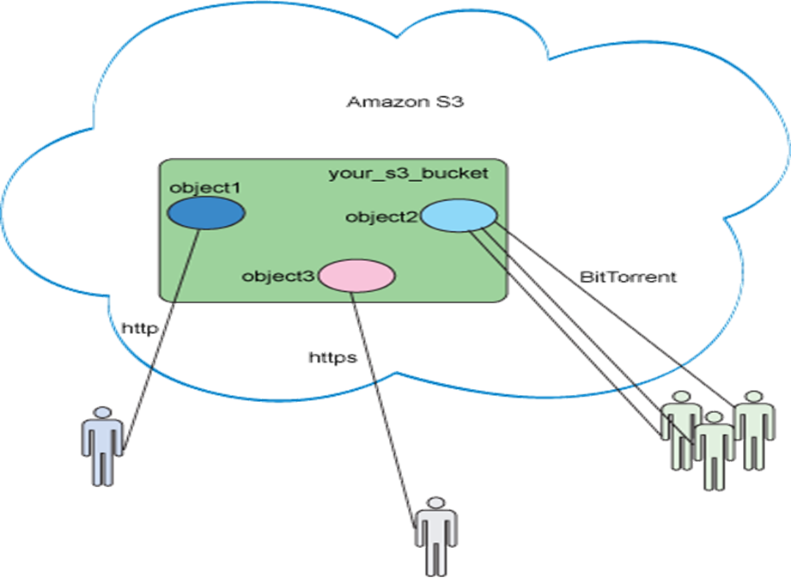
S3 Interface
A simple web services interface for storing and retrieving any amount of data, at any time, from anywhere on the web.
It gives any developer access to the same highly scalable, reliable, fast, inexpensive data storage infrastructure that Amazon uses to run its own global network of web sites.
The service aims to maximize benefits of scale and to pass those benefits on to developers.

Slide 12
Practice: Working with Amazon S3 Buckets
To upload your data (photos, videos, documents etc.), you first create a bucket in one of the AWS Regions. You can then upload any number of objects to the bucket.
In terms of implementation, buckets and objects are resources, and Amazon S3 provides APIs for you to manage them. For example, you can create a bucket and upload objects using the Amazon S3 API. You can also use the Amazon S3 console to perform these operations. The console uses the Amazon S3 APIs to send requests to Amazon S3.
https://docs.aws.amazon.com/AmazonS3/latest/dev/UsingBucket.html

Slide 13

Amazon EC2
Amazon Elastic Compute Cloud (Amazon EC2) provides resizable computing capacity in the Amazon Web Services (AWS) cloud.
Using Amazon EC2 eliminates your need to invest in hardware up front, so you can develop and deploy applications faster.
You can use Amazon EC2 to launch as many or as few virtual servers as you need, configure security and networking, and manage storage.
Amazon EC2 enables you to scale up or down to handle changes in requirements or spikes in popularity, reducing your need to forecast traffic.

Slide 14
EC2 – Elastic Cloud Computing
EC2 - web service for launching instances of an application under several operating systems, such as:
Several Linux distributions
Microsoft Windows Server
FreeBSD
NetBSD
…
A user can
Load an EC2 instance with a custom application environment.
Manage network’s access permissions.
Run the image using as many or as few systems as desired.
…
Users can access:
Images provided by Amazon.
Customize an image and store it in S3.
…

Slide 15
EC2 Features
Virtual computing environments, known as instances
Pre-configured templates for your instances, known as Amazon Machine Images (AMIs), that package the bits you need for your server
Various configurations of CPU, memory, storage, and networking capacity for your instances, known as instance types
Secure login information for your instances using key pairs
AWS stores the public key, and you store the private key in a secure place
Storage volumes for temporary data that's deleted when you stop or terminate your instance, known as instance store volumes

Slide 16
EC2 Features – cont.
Persistent storage volumes for your data using Amazon Elastic Block Store (Amazon EBS), known as Amazon EBS volumes
Multiple physical locations for your resources, known as regions and Availability Zones
A firewall that enables you to specify the protocols, ports, and source IP ranges
Static IP addresses for dynamic cloud computing, known as Elastic IP addresses
Metadata, known as tags, that you can create and assign to your Amazon EC2 resources
Virtual networks that are logically isolated from the rest of the AWS cloud, and that you can optionally connect to your own network, known as virtual private clouds (VPCs)

Slide 17
AWS Instances
An instance is a virtual server with a well specified set of resources including: CPU cycles, main memory, secondary storage, communication and I/O bandwidth.
The user chooses:
The region and the availability zone where this virtual server should be placed.
An instance type from a limited menu of instance types.
When launched, an instance is provided with a DNS name, mapped to a private IP address and a public IP address.
The public IP address is assigned for the lifetime of an instance.
An instance can request an elastic IP address, rather than a public IP address. The elastic IP address is a static public IP address allocated to an instance from the available pool of the availability zone.
An elastic IP address is not released when the instance is stopped or terminated and must be released when no longer needed.

Slide 18
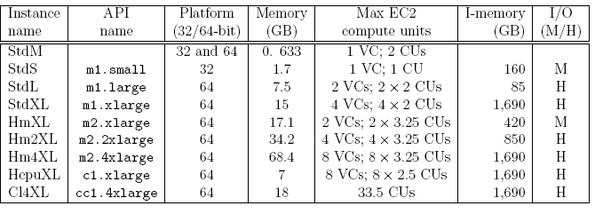
Instance types
Standard instances: micro (StdM), small (StdS), large (StdL), extra large (StdXL); small is the default.
High memory instances: high-memory extra large (HmXL), high-memory double extra large (Hm2XL), and high-memory quadruple extra large (Hm4XL).
High CPU instances: high-CPU extra large (HcpuXL).
Cluster computing: cluster computing quadruple extra large (Cl4XL).
aws.amazon.com

Slide 19
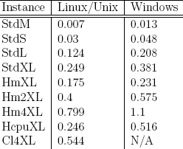

Instance cost
A main attraction of the Amazon cloud computing is the low cost.
Note: price subject to change.
See updates at https://aws.amazon.com/ec2/pricing/on-demand/

Slide 20
Activity #2
What does EC2 stand for?
What does S3 stand for?
What services Google provides equivalent to EC2 and S3 respectively?

Slide 21
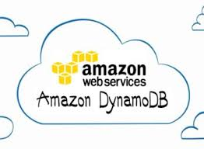
Amazon DynamoDB
aws.amazon.com/dynamodb/

Slide 22
What is DynamoDB?
DynamoDB
a fully managed proprietary NoSQL database service that is offered by Amazon.com as part of the Amazon Web Services portfolio
DynamoDB was announced by Amazon on January 18, 2012
Dynamo (storage system)
Dynamo is the name given to a set of techniques that when taken together can form a highly available key-value structured storage system[or a distributed data store
Amazon DynamoDB derives its name from Dynamo, but is not at all related in any other way. Dynamo has a multi-master design requiring the client to resolve version conflicts whereas DynamoDB has a single master design.

Slide 23
What is a NoSQL database?
NoSQL datastores provide a mechanism for retrieval and storage of data items that is modeled in a non-tabular manner.
Simplicity of design, horizontal scalability and control over availability form the motivations for this approach.
Since DynamoDB is a fully managed service, users need not worry about provisioning & managing of the underlying infrastructure. All is taken care.

Slide 24
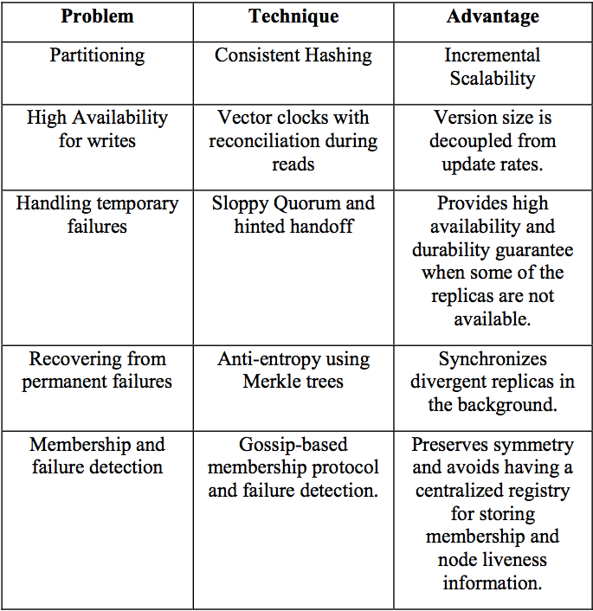
Techniques used in Dynamo
https://cloudacademy.com

Slide 25
Example: Partitioning problems
Let’s take an example to understand the problem.
Consider a system with 3 nodes: NODE1, NODE2 and NODE3.
In a traditional system, a WRITE to NODE2 must be replicated to NODE1 and NODE3 and only then is the WRITE operation considered successful.
This synchronized replication takes time to complete during which time the system is NOT available.
But systems using DynamoDB have the option to defer this update in exchange for higher availability.
So a WRITE to NODE2 is considered successful as long as NODE2 is able to honor that request.
NODE2 eventually replicates it to NODE1 and NODE3.
DynamoDB usually takes a second (or a maximum of a couple of seconds) to achieve consistency across all nodes.

Slide 26
Consistent Hashing
The key design requirement for DynamoDB is to scale incrementally.
In order to achieve this, there must be a mechanism in place that dynamically partitions the entire data over a set of storage nodes.
The basic consistent hashing algorithm presents some challenges
the random position assignment of each node on the ring leads to non-uniform data and load distribution
insensible to the heterogeneity in the performance of nodes.
DynamoDB employs consistent hashing for this purpose.
Consistent hashing is a special kind of hashing such that when a hash table is resized and consistent hashing is used, only K/n keys need to be remapped on average, where K is the number of keys, and n is the number of slots. In contrast, in most traditional hash tables, a change in the number of array slots causes nearly all keys to be remapped.

Slide 27
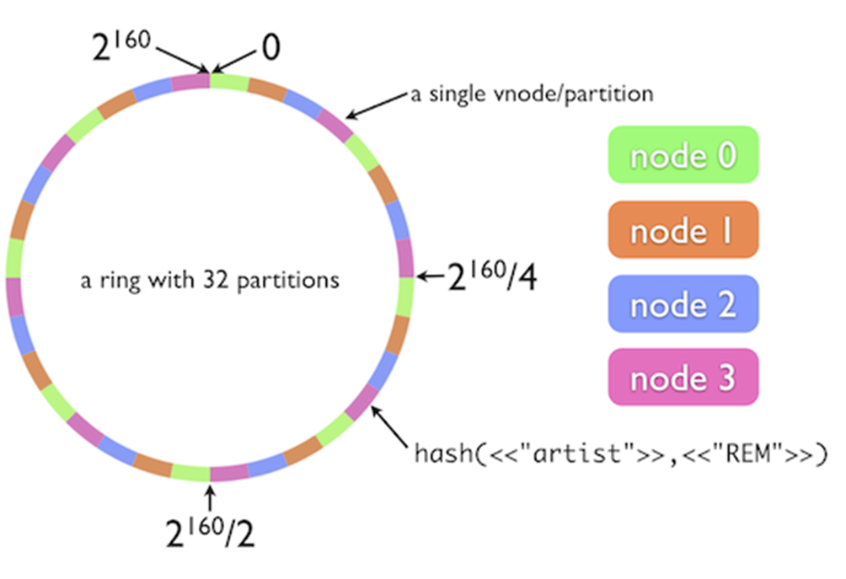
Partitioning in DynamoDB
Dynamo uses a variant of consistent hashing
instead of mapping a node to a single point in the circle, each node gets assigned to multiple points in the ring
use the concept of “virtual nodes”
A virtual node looks like a single node in the system, but each node can be responsible for more than one virtual node.
Effectively, when a new node is added to the system, it is assigned multiple positions in the ring.
https://cloudacademy.com

Slide 28
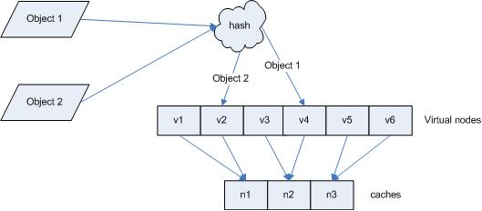
Vritual Nodes in DynamoDB’s Consistent Caching
https://cloudacademy.com

Slide 29
More on DynamoDB consistent hashing and partitioning problem
see https://docs.aws.amazon.com/amazondynamodb/latest/developerguide/HowItWorks.Partitions.html

Slide 30
Other Amazon cloud computing products
Amazon Simple Queue Service (SQS)
reliable and scalable hosted queues for storing messages
By using Amazon SQS, you can move data between distributed components of your applications that perform different tasks without losing messages or requiring each component to be always available.
The queue acts as a buffer between the component producing and saving data, and the component receiving the data for processing.
Amazon Relational Database Service (Amazon RDS)
a web service that makes it easier to set up, operate, and scale a relational database in the cloud
provides cost-efficient, resizable capacity for an industry-standard relational database and manages common database administration tasks.
Amazon CloudFront is a content delivery network (CDN) offered by Amazon Web Services
CloudFront now has 51 edge locations across the Globe
designed as a content delivery network to serve static assets such as CSS or JavaScript files from edge cache locations.

Slide 31
SimpleDB
Non-relational data store. Supports store and query functions traditionally provided only by relational databases.
Supports high performance Web applications; users can store and query data items via Web services requests.
Creates multiple geographically distributed copies of each data item.
CloudWatch
Monitoring infrastructure used by application developers, users, and system administrators to collect and track metrics important for optimizing the performance of applications and for increasing the efficiency of resource utilization.
Without installing any software a user can monitor either seven or eight pre-selected metrics and then view graphs and statistics for these metrics.
When launching an Amazon Machine Image (AMI) the user can start the CloudWatch and specify the type of monitoring:
Basic Monitoring - free of charge; collects data at five-minute intervals for up to seven metrics.
Detailed Monitoring - subject to charge; collects data at one minute interval.

Slide 32
Activity #3
Discussion:
Comparing the giants: Google vs. Amazon in cloud services
What services they provide are similar to each other?
What differences you see in the way the two company provide cloud services?
Which one provides clearer descriptions to its cloud services?
Which one is better to get started for the beginners?

Slide 33
Summary
Discussion of selected AWS cloud computing products/services
Assignment
Compare and contrast cloud products/services provided by Google and AWS.
Write up following in-class activity #3 discussions.
Dropbox (https://www.dropbox.com/) is another popular cloud storage provider. Research the storage services (functionality and features) provided by Dropbox, compare and contrast with AWS S3.
Optional: Challenges and opportunities of cloud computing (students reading and thinking guidelines)
Business and infrastructure related issues
Security and privacy issues
Next lecture: Microsoft Azure

